Slide 1

Methods
“Take a method and try it. If it fails, admit it frankly, and try another. But by all means, try something.”
– Franklin D. Roosevelt

Slide 2
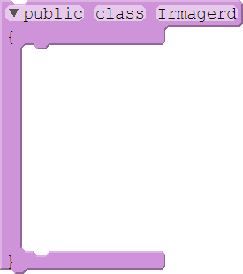
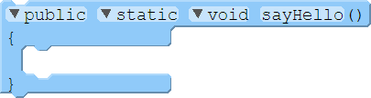
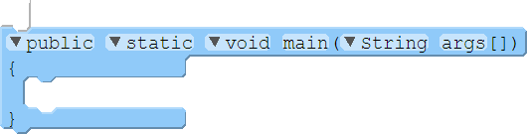

Methods & Functions
In CS, a function is a named block of instructions. A function within a class is called a method.
01 02 03 04 05 06 07 08 09 10 11 12
public class Irmagerd
{
public static void sayHello()
{
System.out.println("Hello. I'm Batman.");
}
public static void main(String args[])
{
sayHello();
}
}
Invoking a function’s name (a function call or method call) causes it to execute.

Slide 3
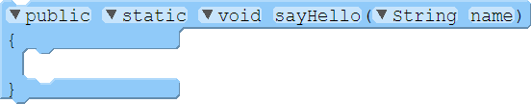

Parameters & Arguments
We can establish that a function requires parameters. Values passed in are arguments.
01 02 03 04 05 06 07 08 09 10 11 12
public class Irmagerd
{
public static void sayHello(String name)
{
System.out.println("Hello, I'm " + name + ".");
}
public static void main(String args[])
{
sayHello("Batman");
}
}
Parameter definition
Argument
OUTPUT:
Hello, I’m Batman.

Slide 4
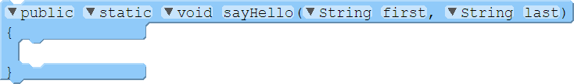

Parameters & Arguments
Functions and methods can also have multiple parameters:
01 02 03 04 05 06 07 08 09 10 11 12
public class Irmagerd
{
public static void sayHello(String first, String last)
{
System.out.println("Hello, I'm " + first + " " + last + ".");
}
public static void main(String args[])
{
sayHello("Bat", "Man");
}
}
OUTPUT:
Hello, I’m Bat Man.

Slide 5
Method overloading
Method Overloading allows a class to have more than one method having the same name with different parameter list
01 02 03 04 05 06 07 08 09 10 11 12 13 14 15 16 17 18 19 20 21
public class Irmagerd {
public static void sayHello() {
System.out.println("Hello. I'm Batman.");
}
public static void sayHello(String name) {
System.out.println("Hello, I'm " + name + ".");
}
public static void sayHello(String first, String last)
{
System.out.println("Hello, I'm " + first + " " + last + ".");
}
public static void main(String args[])
{
sayHello("Batman");
}
}

Slide 6
Methods - Primitive arguments & Return statement

Slide 7
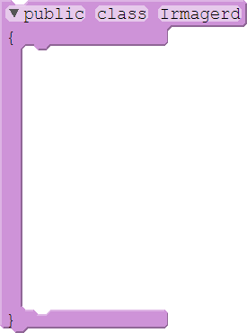
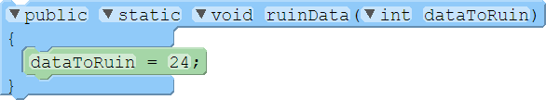
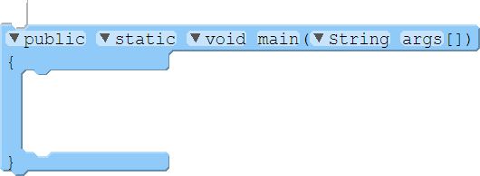


Primitive Arguments
Methods make a copy of the arguments for internal use – they don’t use the original variable:
01 02 03 04 05 06 07 08 09 10 11 12 13 14
public class Irmagerd
{
public static void ruinData(int dataToRuin)
{
dataToRuin = 24;
}
public static void main(String args[])
{
int data = 42;
ruinData(data);
System.out.println("The data is " + data + ".");
}
}
STACK:
main():
args
data
42
ruinData():
dataToRuin
24
42
42
OUTPUT:
The data is 42.
When a function is called, the computer must allocate memory on the call stack for it.

Slide 8
Practice Question
What is the output of the following program?
STACK:
01 02 03 04 05 06 07 08 09
public static void main(String[] args) {
int myValue = 32;
comeAddMeBro(myValue);
System.out.println(myValue);
}
public static void comeAddMeBro(int value) {
value = value + 10;
}
main():
args
myValue
32
32
comeAddMeBro():
value
42
32
32
42
Syntax Error
Runtime Error

Slide 9
How could we print 42 rather than 32
What is the output of the following program?
STACK:
01 02 03 04 05 06 07 08 0910
public static void main(String[] args) {
int myValue = 32;
comeAddMeBro(myValue);
System.out.println(myValue);
}
public static void comeAddMeBro(int value) {
value = value + 10;
}
main():
args
myValue
32
myValue =
42
comeAddMeBro():
value
42
32
int
return value;
32
42
Syntax Error
Runtime Error

Slide 10
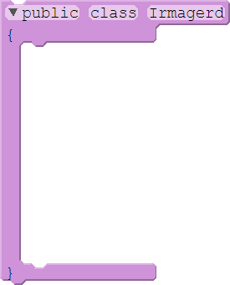
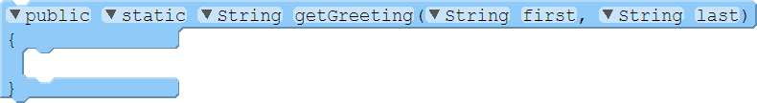
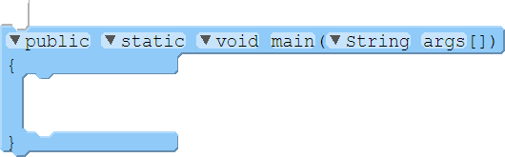

Return Values
Some functions and methods can have a return value.
01 02 03 04 05 06 07 08 09 10 11 12 13
public class Irmagerd
{
public static String getGreeting(String first, String last)
{
return "Hello, I'm " + first + " " + last + ".";
}
public static void main(String args[])
{
String greeting = getGreeting("Bat", "Man");
System.out.println(greeting);
}
}
OUTPUT:
Hello, I’m Bat Man.

Slide 11
Practice Question – Return Statement
What is the output of the following program?
01 02 03 04 05 06 07 08 0910 11 12 13 14 15 16
public static void main(String s[])
{
int a = 4;
int b = 6;
int c = 0;
sum(a, b);
System.out.println(c);
}
public static int sum(int a, int b)
{
a = a + 10;
b = b + 20;
int c = a + b;
return c;
}
0
40
Compile Error

Slide 12
Practice Question – Use Return value
What is the output of the following program?
01 02 03 04 05 06 07 08 0910 11 12 13 14 15
public static void main(String s[])
{
int a = 4;
int b = 6;
int c = sum(a, b);
System.out.println(c);
}
public static int sum(int a, int b)
{
a = a + 10;
b = b + 20;
int c = a + b;
return c;
}
0
40
Compile Error

Slide 13
Methods - Variable scope

Slide 14
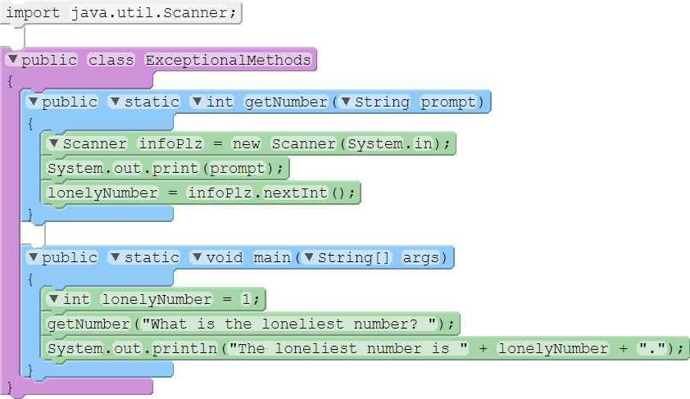
Variable Scope
A variable declared in one function is not in scope in other functions.
01 02 03 04 05 06 07 08 09 10 11 12 13 14 15 16 17 18
import java.util.Scanner;
public class ExceptionalMethods
{
public static int getNumber(String prompt)
{
Scanner infoPlz = new Scanner(System.in);
System.out.print(prompt);
lonelyNumber = infoPlz.nextInt();
}
public static void main(String[] args)
{
int lonelyNumber = 1;
getNumber("What is the loneliest number? ");
System.out.println("The loneliest number is " + lonelyNumber + ".");
}
}

Slide 15
Practice Question – Variable scope
What is the output of the following program?
01 02 03 04 05 06 07 08 0910 11 12 13 14 15
public static void main(String s[])
{
int a = 4;
int b = 6;
sum(a, b);
System.out.println(c);
}
public static int sum(int a, int b)
{
a = a + 10;
b = b + 20;
int c = a + b;
return c;
}
0
40
Compile Error

Slide 16
Practice Question – Variable scope
What is the output of the following program?
01 02 03 04 05 06 07 08 0910 11 12 13 14 15 16
public static void main(String s[])
{
int a = 4;
int b = 6;
int c = 8;
c = sum(b, c);
System.out.println(c);
}
public static int sum(int a, int b)
{
a = a + 10;
b = b + 20;
int c = a + b;
return c;
}
0
40
44
Compile Error

Slide 17
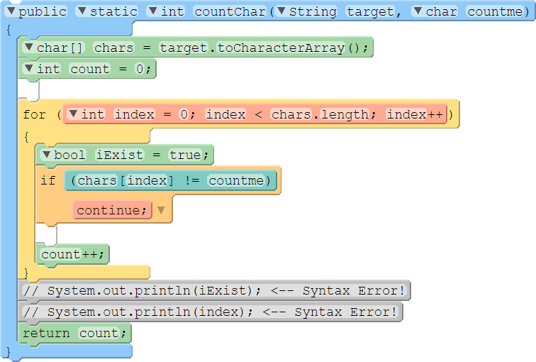
Variable Scope
The scope of a variable is limited to the block it is declared in – sometimes in a loop!
07 08 09 10 11 12 13 14 15 16 17 18 19 20 21 22 23
public static int countChar(String target, char countme)
{
char[] chars = target.toCharacterArray();
int count = 0;
for (int index = 0; index < chars.length; index++)
{
bool iExist = true;
if (chars[index] != countme)
continue;
count++;
}
// System.out.println(iExist); <-- Syntax Error!
// System.out.println(index); <-- Syntax Error!
return count;
}
Method scope
Loop scope
Iteration scope

Slide 18
Practice Question – Variable scope 2
What is the output of the following program?
01 02 03 04 05 06 07 08 0910
public static void main(String s[]) {
int n = 1234;
while (n != 0) {
int sum = 0;
int lastDigit = n % 10;
sum = sum + lastDigit;
n = n/10;
}
System.out.println(sum);
}
0
1
10
Compile Error

Slide 19



Why Bother with methods?
The main reasons:
Readability
Modularity
Code reuse
Also helps with:
Abstraction
In object-oriented languages, methods are also how we break up instructions to objects.

Slide 20
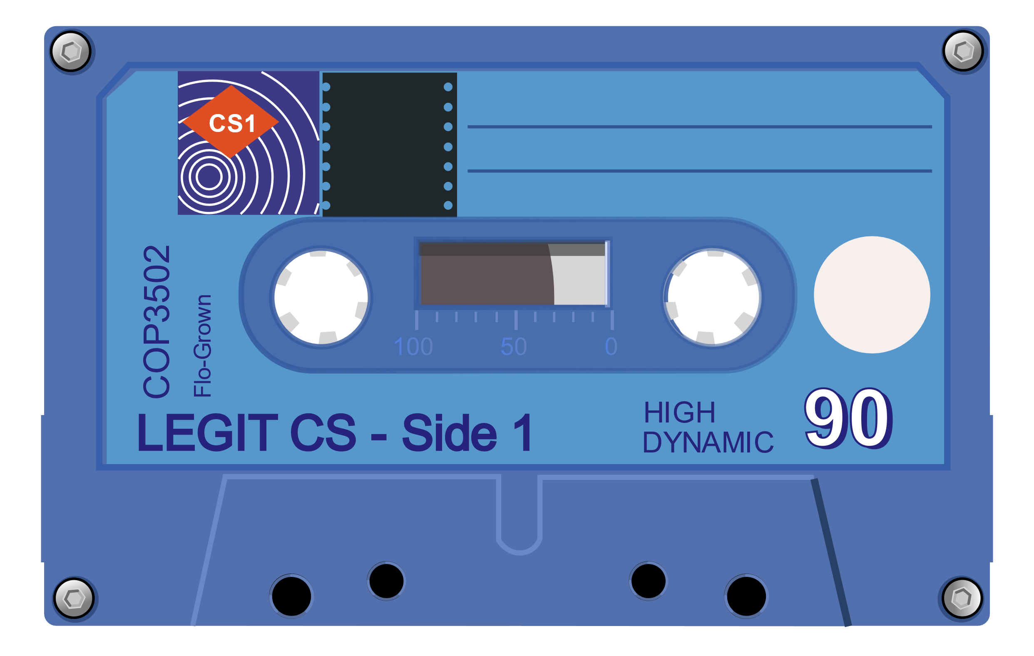
Data Types - Number System
“Data! Data! Data! I can’t make bricks without clay!”
– Sir Arthur Conan Doyle

Slide 21
Number system
In mathematics, a base is the number of different digits or combination of digits and letters that a system of counting uses to represent numbers
Base 10 (Decimal) | Represent any number using 10 digits [0 - 9]
Base 2 (Binary) | Represent any number using 2 digits [0 - 1]
Base 8 (Octal) | Represent any number using 8 digits [0 - 7]
Base 16 (Hexadecimal) | Represent any number using 10 digits and 6 characters [0 – 9, A, B, C, D, E, F]
Dec | 0 | 1 | 2 | 3 | 4 | 5 | 6 | 7 | 8 | 9 | 10 | 11 | 12 | 13 | 14 | 15
Bin | 0000 | 0001 | 0010 | 0011 | 0100 | 0101 | 0110 | 0111 | 1000 | 1001 | 1010 | 1011 | 1100 | 1101 | 1110 | 1111
Oct | 00 | 01 | 02 | 03 | 04 | 05 | 06 | 07 | 10 | 11 | 12 | 13 | 14 | 15 | 16 | 17
Hex | 0 | 1 | 2 | 3 | 4 | 5 | 6 | 7 | 8 | 9 | A | B | C | D | E | F

Slide 22
Binary Representation
Computers use binary for all data.
Numbers are stored using binary numbering:
Characters are stored as numbers which represent their symbols:
Bit | Val.
0 | 1
1 | 2
2 | 4
3 | 8
4 | 16
5 | 32
6 | 64
7 | -128
A
B
Z
a
z
↵
!
65
66
90
97
122
13
33
01000001
01000010
01011010
01100001
01111010
00001101
00100001
73
01001001
64 + 8 + 1

Slide 23
Binary to decimal
Question: Convert binary number 01001001 to decimal number.
Bit Index
7 | 6 | 5 | 4 | 3 | 2 | 1 | 0
Binary #
0 | 1 | 0 | 0 | 1 | 0 | 0 | 1
-2⁷ | 2⁶ | 2⁵ | 2⁴ | 2³ | 2² | 2¹ | 2⁰
-2⁷ *0 | 2⁶ *1 | 2⁵ *0 | 2⁴*0 | 2³ *1 | 2²*0 | 2¹ *0 | 2⁰ *1
64 + 8 + 1 = 73

Slide 24
Binary to decimal – Highest order bit
byte num =
?
10001000
Byte data type: 8 bits, value range [-128, 127]
The highest order bit is a sign bit to indicate the number is positive or negative
Bit | Val.
0 | 1
1 | 2
2 | 4
3 | 8
4 | 16
5 | 32
6 | 64
7 | -128
Bit Index
7 | 6 | 5 | 4 | 3 | 2 | 1 | 0
Binary #
1 | 0 | 0 | 0 | 0 | 0 | 0 | 0
-2⁷ | 2⁶ | 2⁵ | 2⁴ | 2³ | 2² | 2¹ | 2⁰
-128
-128 | 64*0 | 32*0 | 16*0 | 8*0 | 4*0 | 2*0 | 1*0
Binary #
0 | 1 | 1 | 1 | 1 | 1 | 1 | 1
-2⁷ | 2⁶ | 2⁵ | 2⁴ | 2³ | 2² | 2¹ | 2⁰
-128*0 | 64 | 32 | 16 | 8 | 4 | 2 | 1
0 + 64 + 32 + 16 + 8 + 4+ 2 + 1 = 127

Slide 25
Convert decimal to binary
Base | Decimal
2
2
2
2
2
2
2
2
Reminder
73
36
1
18
0
9
0
Binary Representation of 73
4
1
2
0
1001001
1
0
0
1
STOP

Slide 26
Data Types - Octal and hexadecimal
“Data! Data! Data! I can’t make bricks without clay!”
– Sir Arthur Conan Doyle

Slide 27
Octal and Hexadecimal
Binary to Octal: Group 3 bits at a time.
Binary to Hexadecimal: Group 4 bits at a time
Octal
Hexadecimal
00000001
00000010
00011010
00100001
00111010
00001110
00010001
001
002
032
041
072
016
021
1
2
26
33
58
14
17
01000001
01000010
01011010
01100001
01111010
00001101
00100001
0x41
0x42
0x5A
0x61
0x7A
0x0D
0x21
65
66
90
97
122
13
33
A
B
Z
a
z
↵
!
By convention, octal is prefixed with ‘0’, while hex is prefixed with ‘0x’.
Binary numbers are prefixed with ‘0b’.

Slide 28
Binary to octal
Question: Convert binary number 01011010 to Octal.
Binary
0 | 1 | 0 | 1 | 1 | 0 | 1 | 0
0 | 1
0 | 1 | 1
0 | 1 | 0
2¹ | 2⁰
2² | 2¹ | 2⁰
2² | 2¹ | 2⁰
0*2¹ +1*2⁰
0*2² +1*2¹ +1*2⁰
0*2² +1*2¹ +0*2⁰
Octal
1 3 2

Slide 29
Binary to hexadecimal
Question: Convert binary number 01011010 to Hexadecimal.
Binary
0 | 1 | 0 | 1 | 1 | 0 | 1 | 0
0 | 1 | 0 | 1
1 | 0 | 1 | 0
2³ | 2² | 2¹ | 2⁰
2³ | 2² | 2¹ | 2⁰
0*2³ +1*2² +0*2¹ +1*2⁰
1*2³ +0*2² +1*2¹ +0*2⁰
Hex
5 A

Slide 30
Octal and Hex to decimal
Question: Convert Octal number 111 and Hex number 49 to decimal number.
Bit Index
2 | 1 | 0
Bit Index
1 | 0
Octal
1 | 1 | 1
Hex
4 | 9
8² | 8¹ | 8⁰
16¹ | 16⁰
64 | 8 | 1
16 * 4 | 9 * 1
64 + 8 + 1 = 73
16 * 4 + 9 * 1= 73

Slide 31
Convert decimal to Octal and Hex
Base | Decimal
8
8
8
8
Reminder
Base | Decimal
16
16
16
Reminder
73
73
9
1
4
9
1
1
0
4
0
1
STOP
STOP
Octal Representation of 73
Hex Representation of 73
111
0111
49
or
0x49
or

Slide 32
Methods & Number System Practice questions

Slide 33

Exercise: Sum digits problem
Write a method sumDigits(int n) to sum the digits of a positive number n.
Example:
input n = 1234. return value is 10 ( = 1 + 2 + 3 + 4).

Slide 34
Exercise: Decimal to Binary problem
Write a method convertToBinary(int num) that takes in a positive integer num as input and returns a string of 1’s and 0’s representing the integer in binary.

